Slide 1

THANK YOU FOR YOUR PURCHASE!
You’ll need a Boom Learning account in order to access your Boom Cards.
Don’t have a Boom Learning account yet? Don’t worry! New users will receive a free trial from Boom Learning!
Read here for details: http://bit.ly/BoomTrial.
If you choose not to stay on a premium account after your free trial, you will still be able to assign all your Boom Cards to as many students as you see fit using Fast Play pins (which give instant feedback for decks that are self-grading).
You will not be charged when your free trial expires.

Slide 2
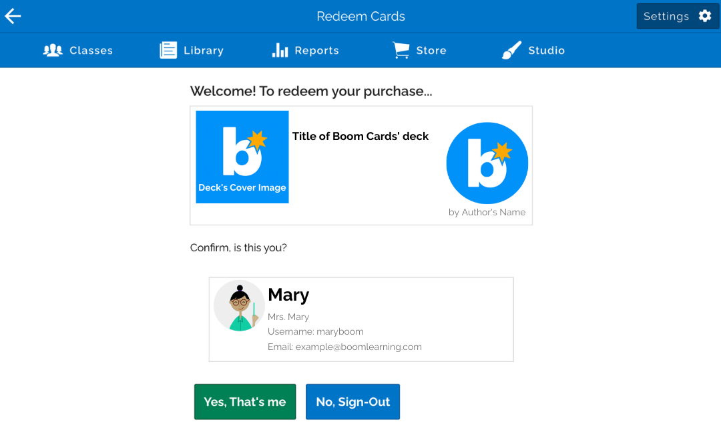
How to
REDEEM YOUR PURCHASE
if you’re signed into Boom:
Click on the “Click here to redeem” box, which contains a special code in it.
Clicking the link will take you to the Boom Learning site and provide a welcome screen and a “Yes, That’s me” and “No, Sign-Out” buttons.
Confirm it’s you.
After doing so, you’ll be prompt to your Library. Use the search bar to look up your purchased deck; please be sure to check the "Purchased Unfoldered" folder.

Slide 3
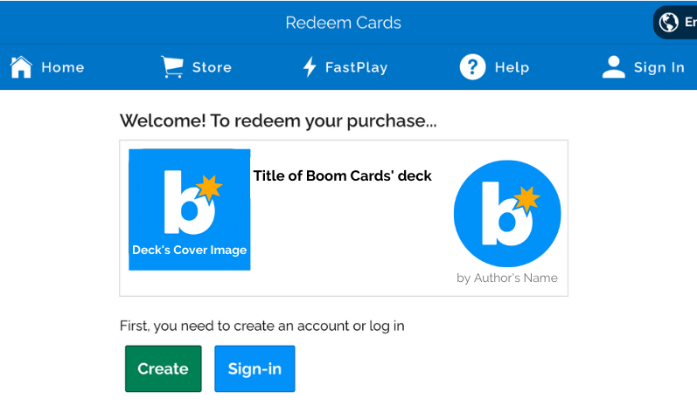
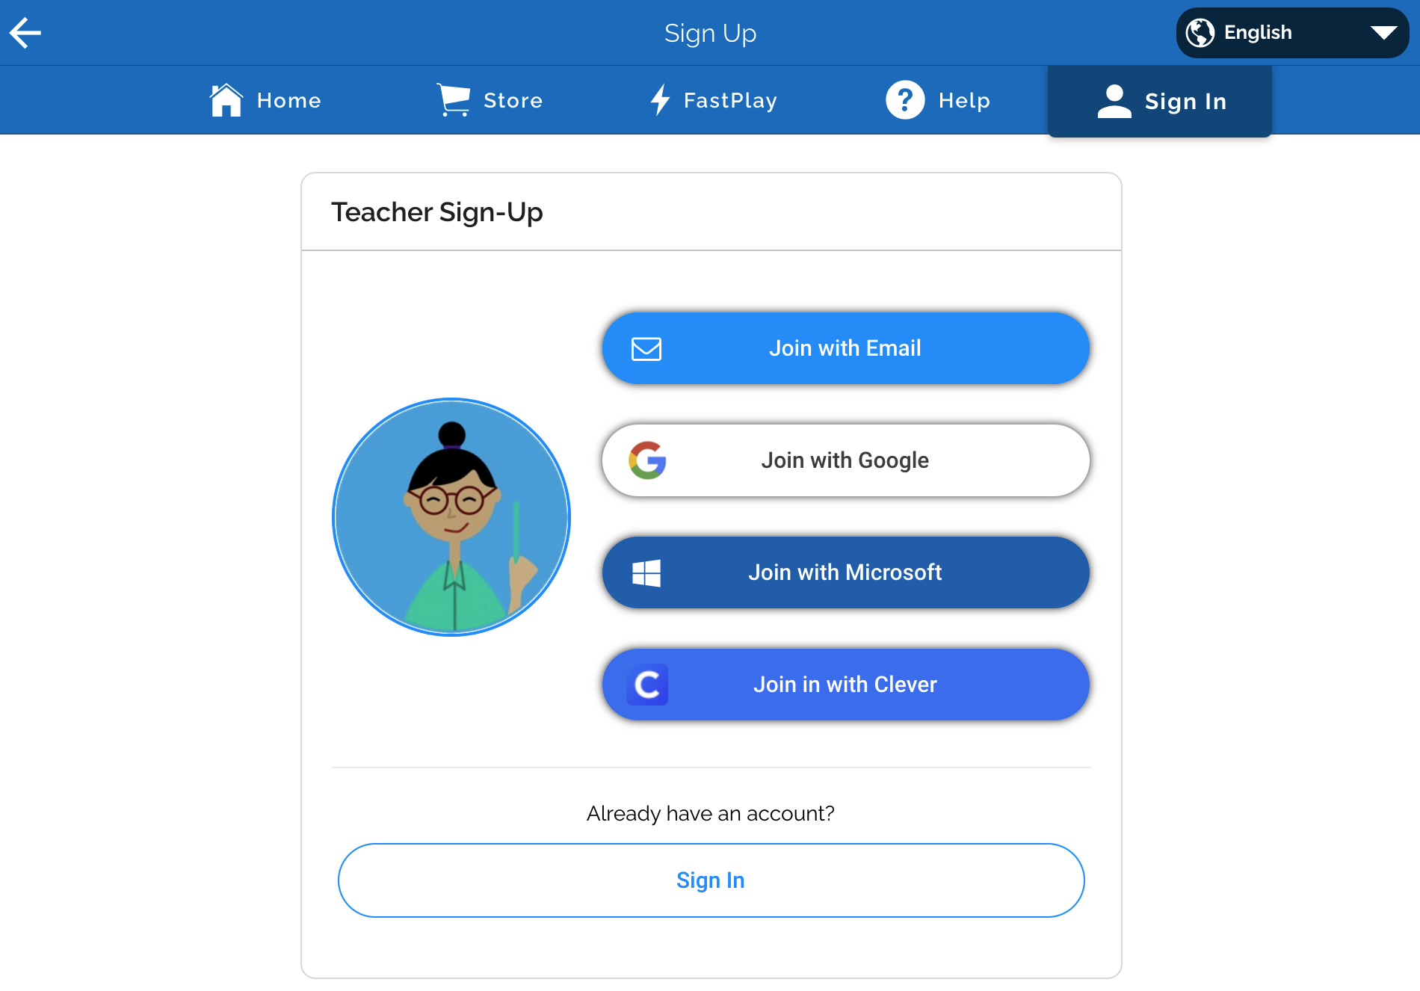
How to REDEEM YOUR PURCHASE if you’re NOT signed into Boom:
Click on the “Click here to redeem” box, which contains a special code in it.
Clicking the link will take you to the Boom Learning site and provide a welcome screen and a “Create” and “Sign-in” buttons.
If you don’t have an account in Boom Learning yet, click on the green “Create” button.
You’ll be prompt to the Teacher Sign-up page, choose your preferred way to join/create your account login.

Slide 4
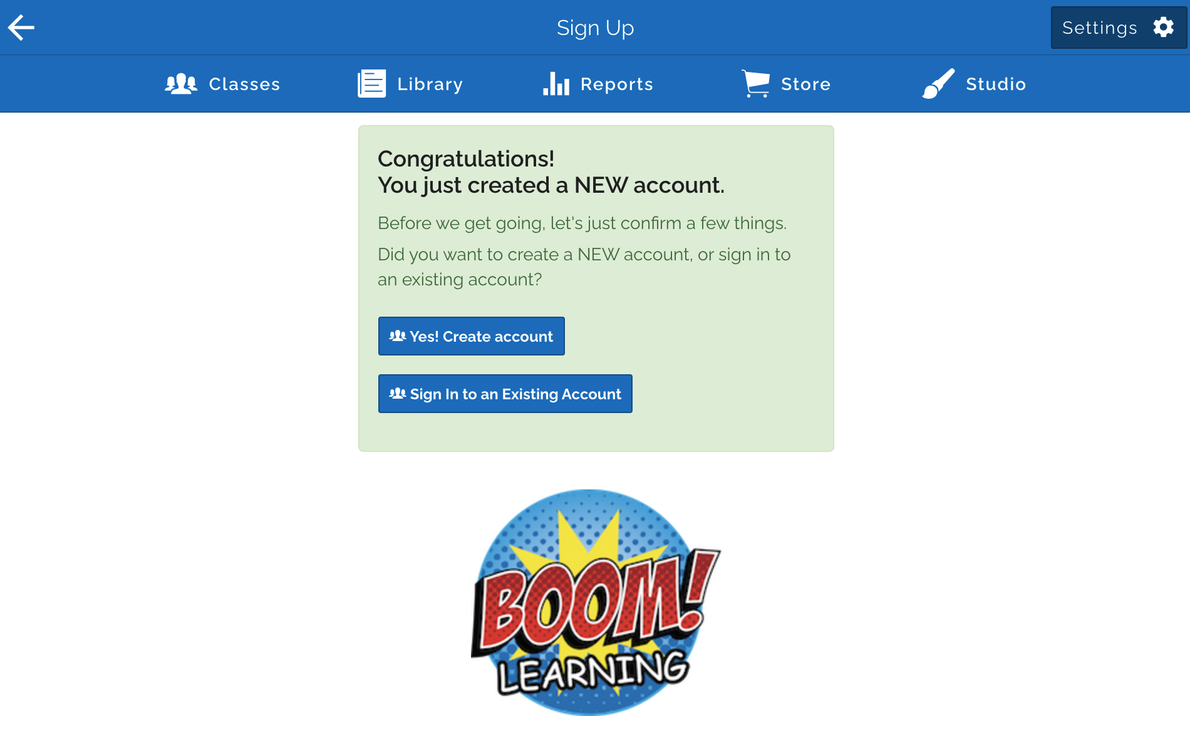
How to REDEEM YOUR PURCHASE if you’re NOT signed into Boom:
After choosing your login method, click on “Yes! Create account” button. This will prompt you to the redemption page.
This will provide a welcome screen and a “Yes, That’s me” and “No, Sign-Out” buttons. Confirm it's you.
After doing so, you’ll be prompt to your Library. Use the search bar to look up your purchased deck; please be sure to check the "Purchased Unfoldered" folder.

Slide 5
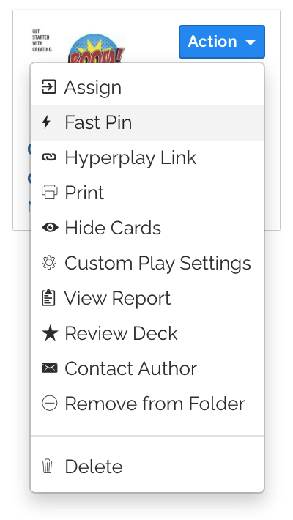
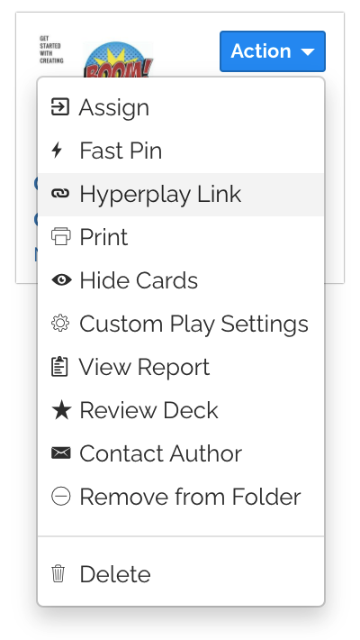
How to
ASSIGN YOUR DECK
to your students:
(From your Library)
Use Fast Pins to distribute a simple link to your students, this does not require your students to log in. FastPins do not allow student reports.
Use HyperPlay link to distribute a simple link to your students, but this does require your students to log in. HyperPlay links does allow student reports.

Slide 6
Acknowledgments

